Slide 1


Automatic Stylistic
Layout
Ying Cao
Antoni B. Chan
Rynson W.H. Lau
City University of Hong Kong

Slide 2

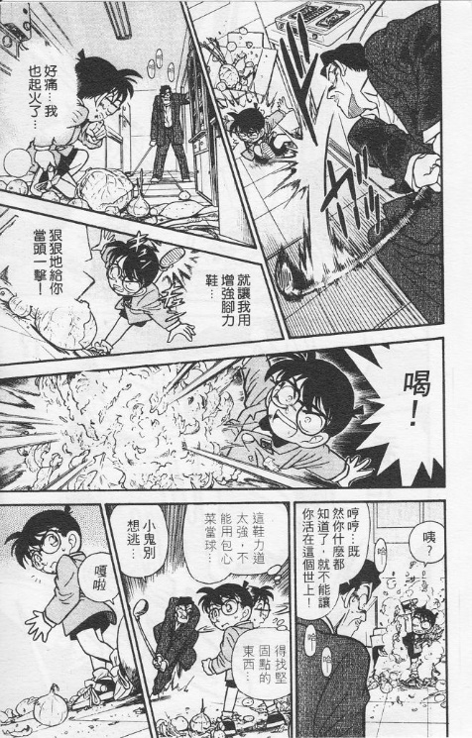
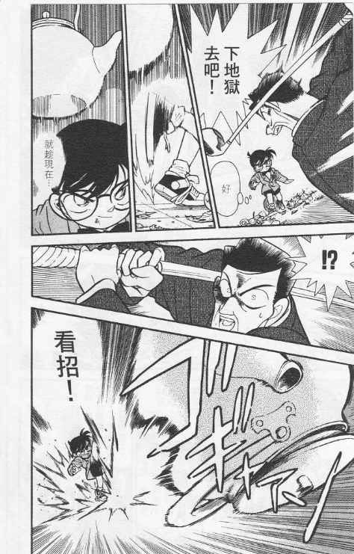
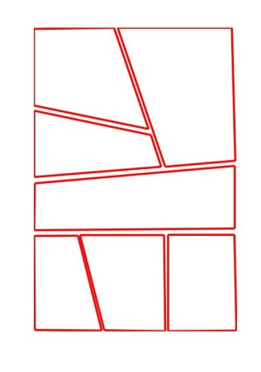
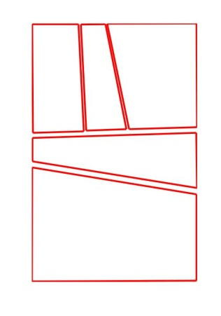
Background
Manga layout is crucial for manga production, with unique styles
©AYOYAMA Gosho / Shogakukan Inc.
Manga pages
Their layouts

Slide 3
Background
Effective manga layout can benefit
  Storytelling
  Attention guidance
  Visual attractiveness
It is a difficult task

Slide 4












Goal
To create high-quality manga layout with ease
1
2
2
3
3
3
Artworks
Semantics
Resulting layout

Slide 5
Challenge
Not a well-studied problem
No explicit rules
Our solution: data-driven strategy to learn stylistic aspects from existing manga pages

Slide 6
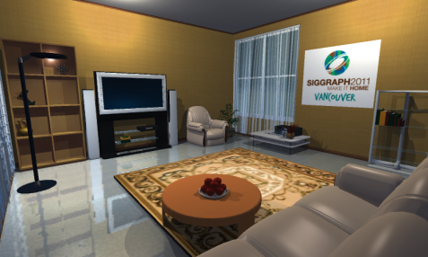
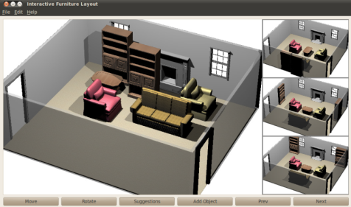
Related Work
General layout problem: global optimization
[ Yu et al. 2011]
[Merrell et al. 2011]

Slide 7
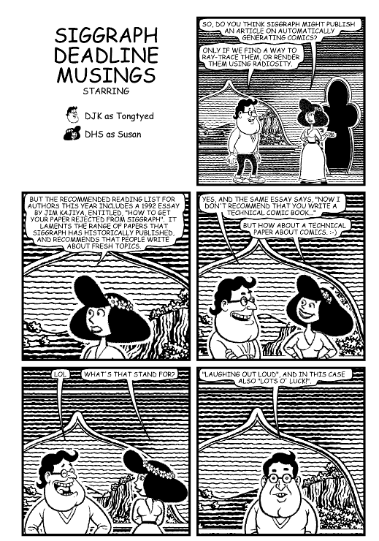
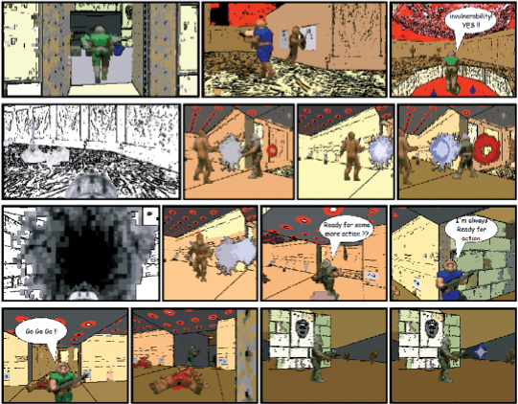

Related Work
Comic layout: heuristic rules or templates
[Kurlander et al. 1996]
[Shamir et al. 2006]
[Preu et al. 2007]

Slide 8

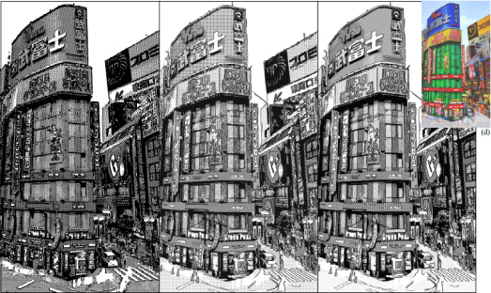
Related Work
Computational Manga
[Qu et al. 2006]
[Qu et al. 2008]

Slide 9

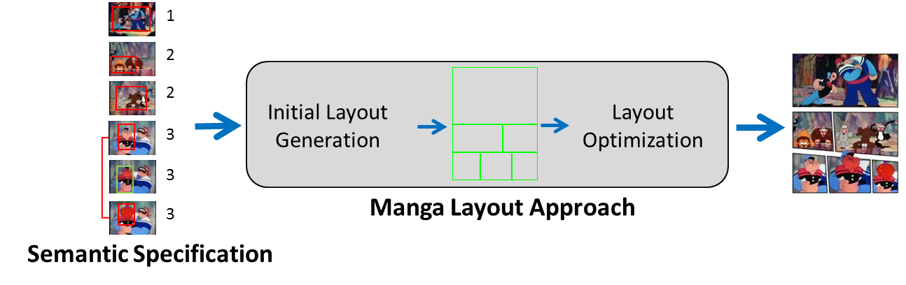
Overview

Slide 10
Overview

Slide 11
Overview

Slide 12
Overview

Slide 13
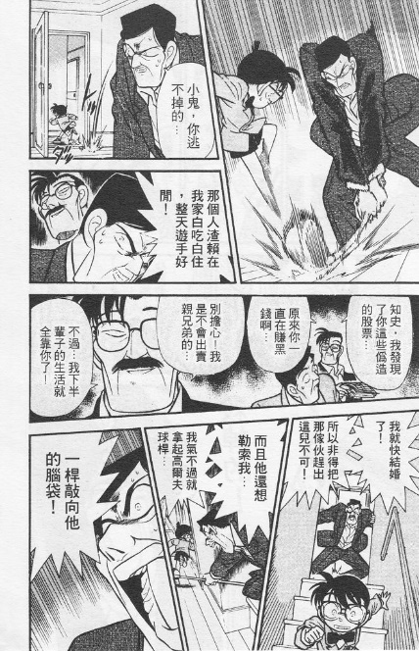
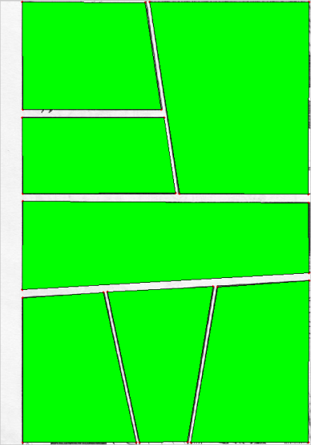
Manga Database
4, 000 scanned manga pages from two manga series
One manga series
…
3-panel pages
4-panel pages
10-panel pages
Panel annotation
Page clustering

Slide 14
Overview

Slide 15
Style Models
Represent stylistic aspects of manga layout
1) Layout structure (i.e., spatial arrangement of panels)
…
2) Panel importance (size)
3) Panel shape
…
1
2
3
Learned from manga examples

Slide 16

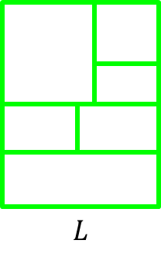

Layout structure Model
A probabilistic generative model:
Synthesize novel plausible layout structures

Slide 17

Layout structure Model
Generative process: recursive spatial division
©AYOYAMA Gosho / Shogakukan Inc.
Root
R1
R2
R3
C2
C1
C1
C3
C2
C1
R1
R2

Slide 18
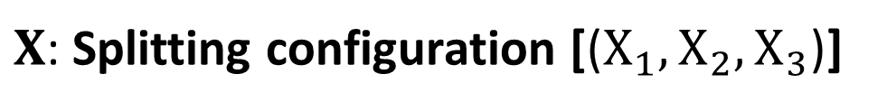


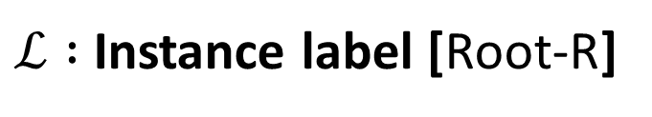


Layout structure Model
Parameterization: spatial division instance
©AYOYAMA Gosho / Shogakukan Inc.
$$X_{1}$$
$ℒ :$ Instance label [Root-R]
$$X_{2}$$
$N$ : Number of rows [3]
$X$: Splitting configuration [($X_{1}, X_{2}, X_{3}$)]
$$X_{3}$$

Slide 19






Layout structure Model
Parameterization: spatial division instance
$$𝓛$$
$ℒ :$ Instance label
$$N$$
$N$ : Number of rows
$X$ : Splitting configuration
$$X$$
Probabilistic graphical model

Slide 20
Layout structure Model
Sample splitting configuration
$$𝓛$$
$ℒ :$ Instance label
$$N$$
$N$ : Number of rows
$X$ : Splitting configuration
$$X$$
Probabilistic graphical model

Slide 21

Layout structure Model
Sample splitting configuration
$$𝓛$$
$ℒ :$ Instance label
Sample
$$N$$
$$X$$
$N$ : Number of rows
$X$ : Splitting configuration
$$X$$
Probabilistic graphical model

Slide 22

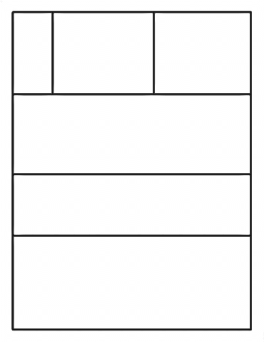
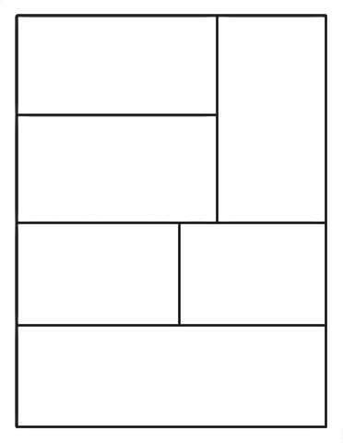
Layout structure Model
  Sampling: recursive splitting using sampled $X$
Training example
Layout structures sampled from our model

Slide 23
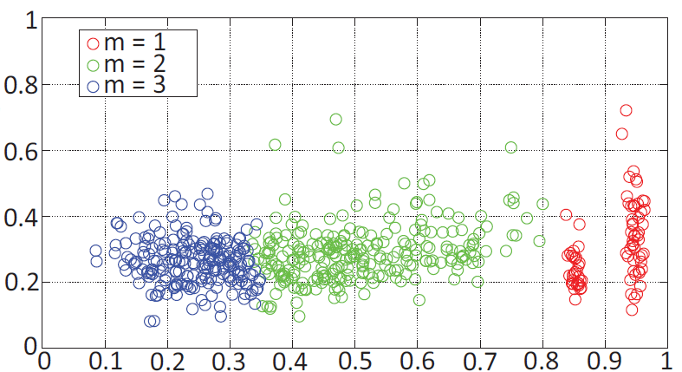

Panel Importance
?
Size
Importance
Shape
Panel clustering
3
2
1
Height
Width
A shape-to-importance classifier
$$m=f\left(x\right)$$

Slide 24

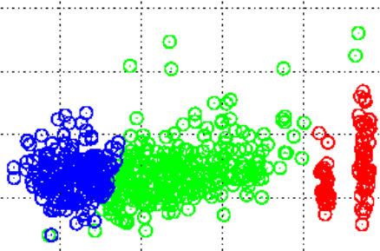



Panel Shape Variation Model
Captures panel shape variability
  Active Shape Model [Cootes et al. 1995]:
$$\{U_{2}, \overline{s_{2}}\}$$
$$\{U_{1}, \overline{s_{1}}\}$$
…
…
$$\{U_{3}, \overline{s_{3}}\}$$
…

Slide 25
Overview

Slide 26




Semantic Specification
Single-panel semantics
Importance
3
Image geometry
Inter-panel semantics
Group of related panels

Slide 27
Overview

Slide 28
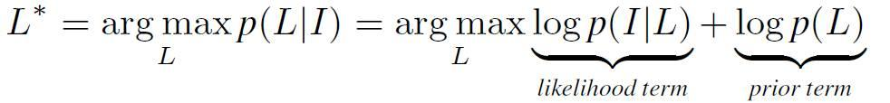


Initial Layout Generation
A layout structure
matches
Input semantics $I$
Existing ones
resembles
Maximum a posteriori (MAP) inference
Fitness between $I$ and $L$
Our generative model

Slide 29


Initial Layout Generation
Likelihood term
Single-panel Likelihood
$$P_{j}$$
$$I_{j}$$
Image geometry
Penalize panel-wise mismatch
in aspect ratio & importance
panel geometry

Slide 30





Initial Layout Generation
Likelihood term
Inter-panel Likelihood

Slide 31
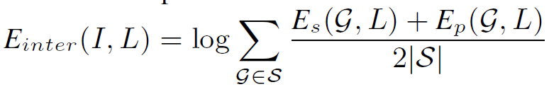
Initial Layout Generation
Likelihood term
Inter-panel Likelihood
Measure the smoothness of path through panels

Slide 32
Initial Layout Generation
Likelihood term
Inter-panel Likelihood
Align group boundary with layout boundary

Slide 33
Initial Layout Generation
Estimate optimal initial layout
    Exact MAP inference is computationally expensive
…
Generative Model
Maximum Posteriori

Slide 34







Layout Optimization
Fit $G$ to $V$ and reproduce panel shape irregularity
Unoptimized

Slide 35
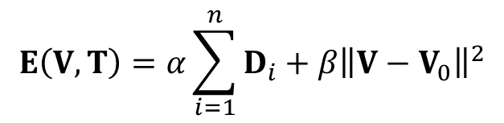




Layout Optimization
Energy function
$$P_{i}$$
Regularization term
$${T_{i}∙I}_{i}$$
Boundary constraint
Collinearity constraint
$$V$$
$$V$$

Slide 36
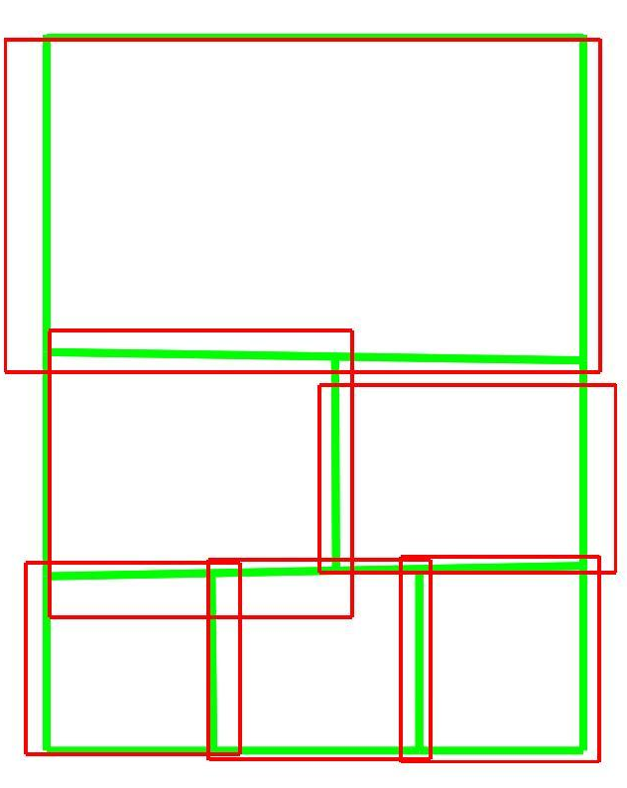
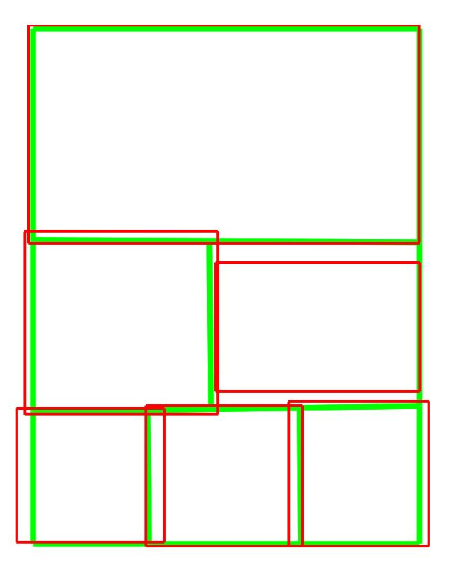
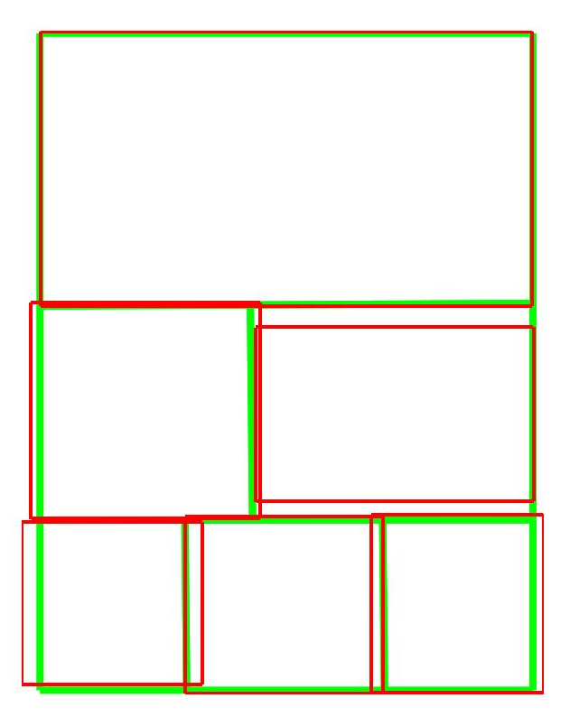
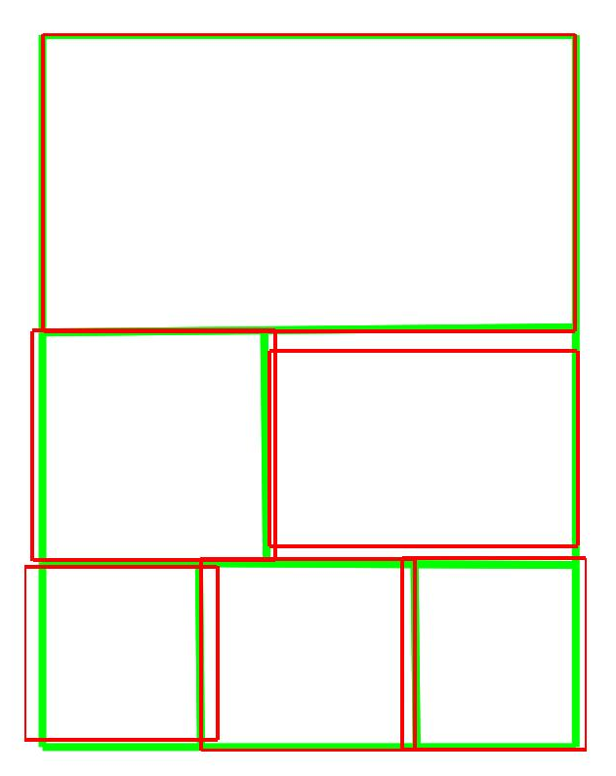
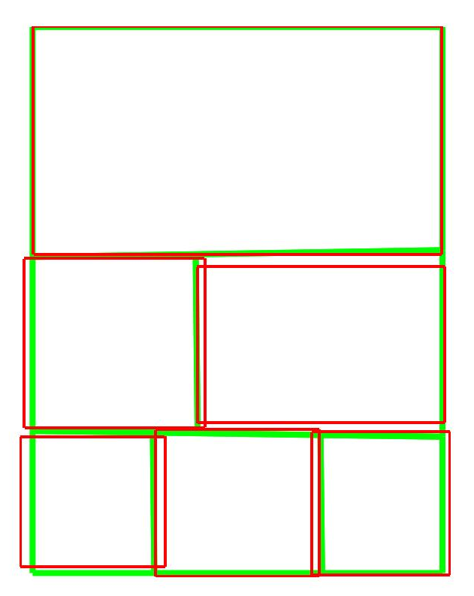
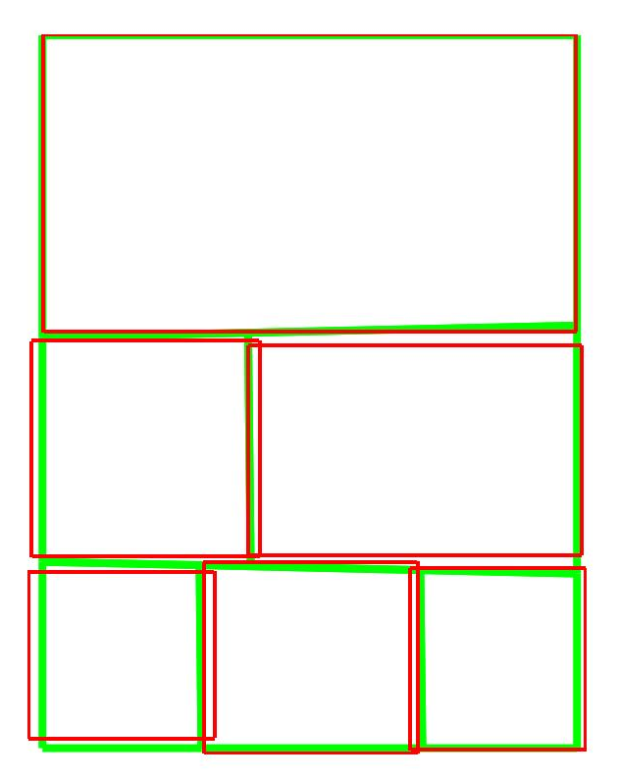
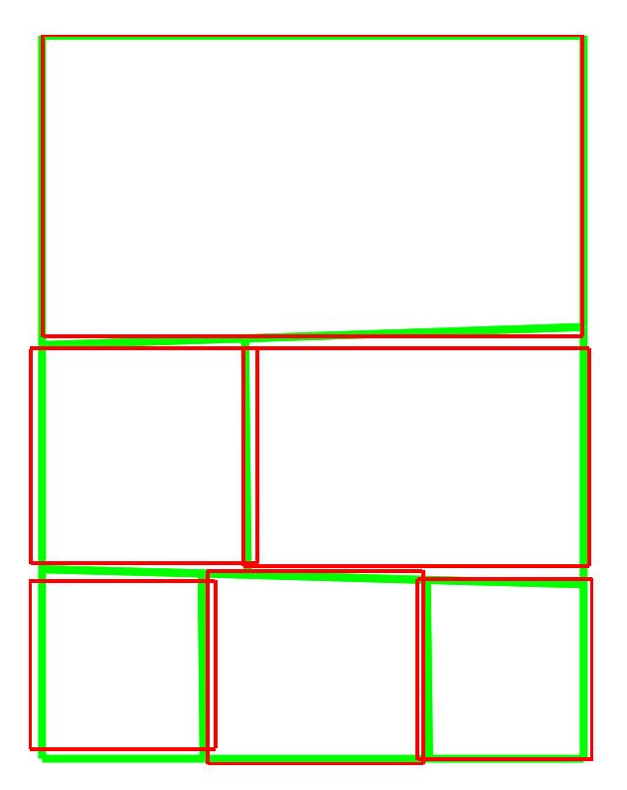
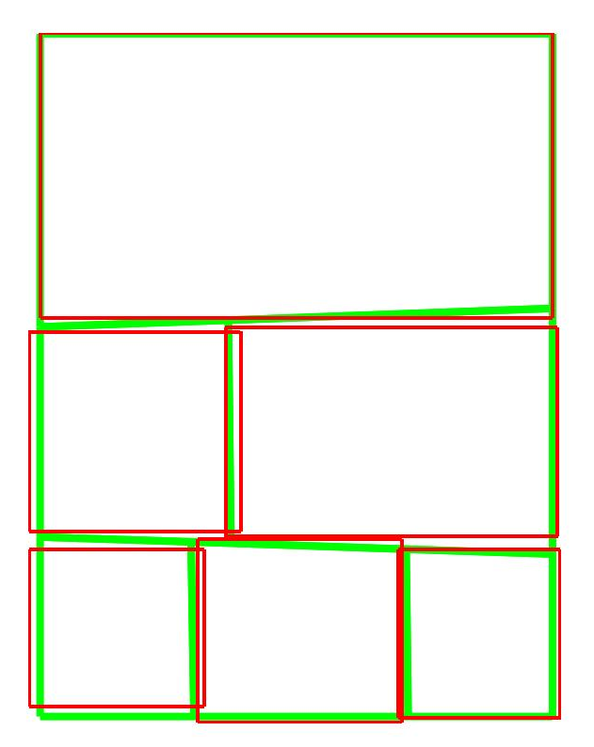
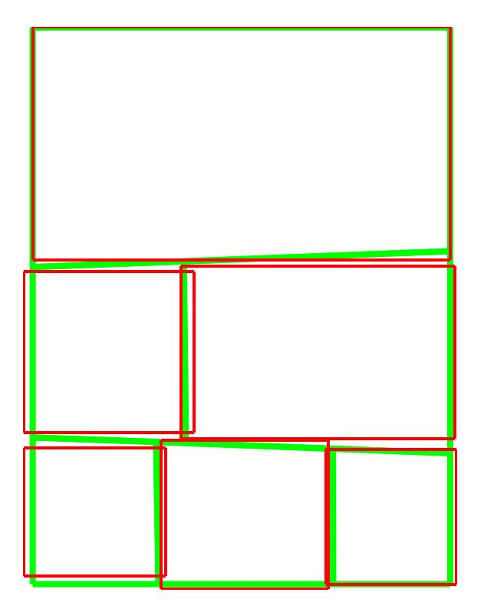
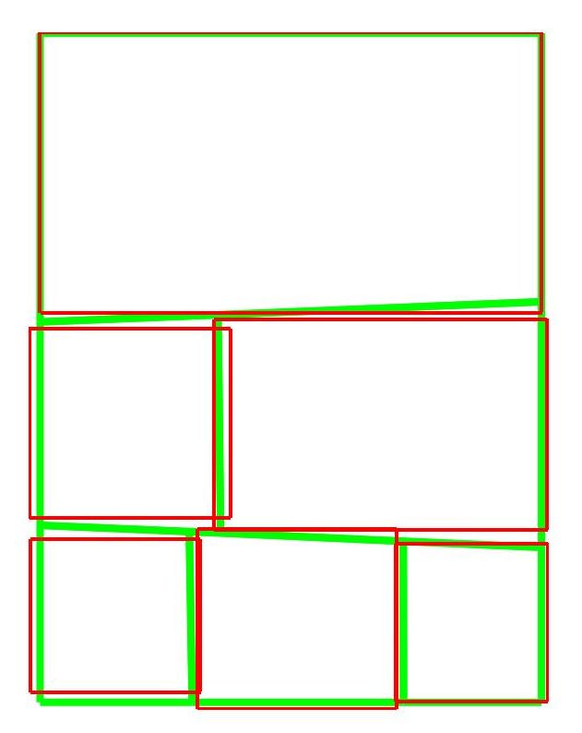
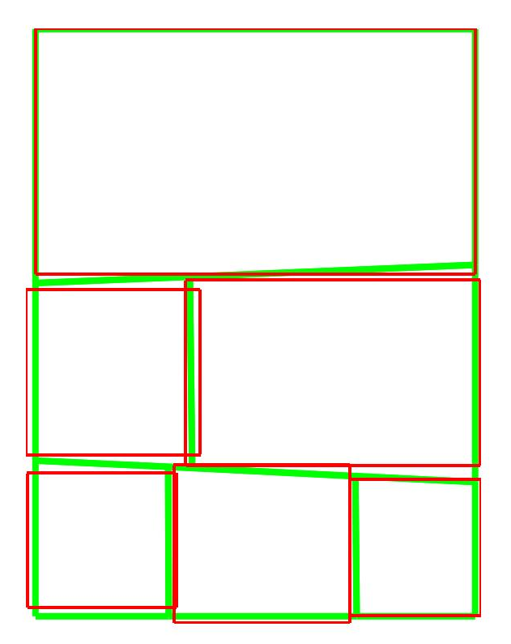
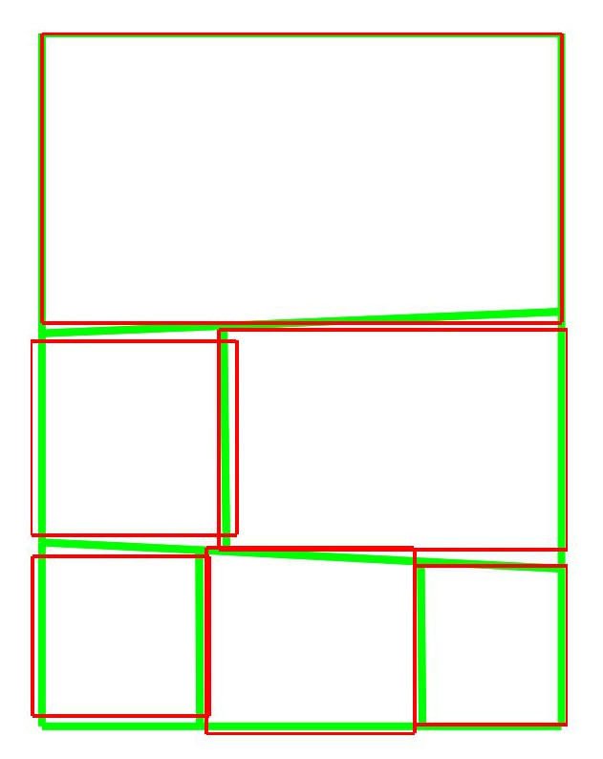
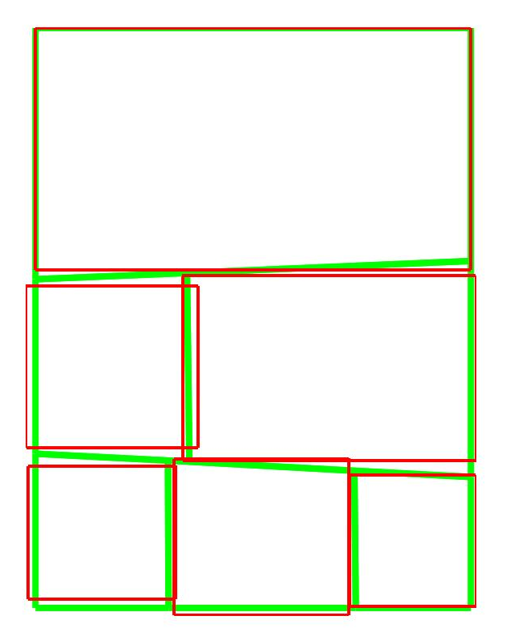
Layout Optimization
Minimize $E\left(V, T\right)$ via an alternating solver

Slide 37















Results
(1)
(1)
(2)
(2)
(2)
(2)
(2)
(3)
(3)
(2)
(3)
(2)
(1)

Slide 38









Comparison with existing manga page
©AYOYAMA Gosho / Shogakukan Inc.
(2)
(3)
(3)
(1)
(3)
(3)
(3)
Input
Our result
Existing manga page

Slide 39








Layouts of different styles
(1)
(2)
(3)
(1)
(3)
(2)
Input
Style of “Fairy Tail”
Style of “Detective Conan”

Slide 40

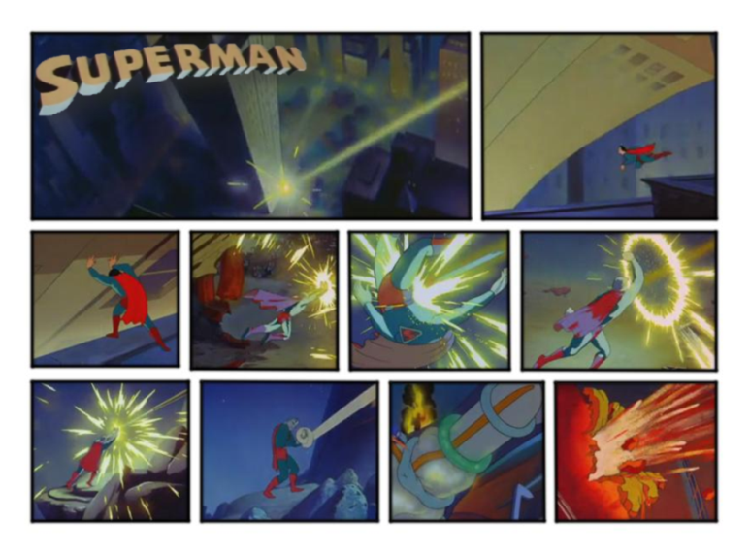
Layouts of Western comic style

Slide 41
User Study
10 participants: manual tool + our tool
10 Evaluators: pairwise comparison

Slide 42
Summary
First attempt to computationally reproduce layout styles of manga
A data-driven approach for automatic generation of stylistic manga layout
Easy and quick production of professional-looking and stylistically rich manga layouts

Slide 43
Limitations & Future Work
  Story pacing
  Art composition & balloon placement
  Generic framework for other layout problems

Slide 44

Thanks

